Slide 1

RAJENDRA MANE COLLEGE OF ENGINEERING AND TECHNOLOGY AMBAV(DEVRUKH)-415804
DEPARTMENT OF COMPUTER ENGINEERING
(2020-21)

Slide 2
PRESENTATION OF MINI PROJECT ON
“VIRTUAL ASSISTANT FOR VISUALLY IMPAIRED”
UNDER GUIDANCE OF:
MS. MANGALE S.R
SUBMITTED BY :
MS.AKSHATA AGINE
MS.SHUBHECHHA LIGAM
MR.KRISHNAT HOGALE

Slide 3
CONTENT
INTRODUCTION
AIM & OBJECTIVES
LITERATURE SURVEY
PROBLEM STATEMENT
METHODOLOGY
REQUIREMENT ANALYSIS
PROJECT DESIGN
IMPLEMENTATION
ADVANTAGES
APPLICATIONS
CONCLUSION
REFERENCES

Slide 4
Blindness is a state of lacking visual perception due to physiological or neurological factors.
Many people suffer from serious visual impairments resulting in lack of knowledge and limited accessibility to information.
One of these techniques is orientation, which helps the visually impaired and blind people in accessing data independently and safely depending on their other remaining senses.
The proposed system is a web portal where user can easily access his/her saved data.
With the help of our speech to text recognition the user can modify, edit, delete the data/notes .
To overcome the above-mentioned limitations, this work offers a simple, efficient, configurable virtual for the blind.
INTRODUCTION

Slide 5
AIM
To provide a web service portal for visually impaired where they can write, read, modify, edit and access information hassle-free on a digital/online system.
OBJECTIVES
Access website independently.
Write, read, delete notes effortlessly.
Greater access to information.
Reduce paperwork.
Less time consuming.
Cost effective
Less resources required.

Slide 6
LITERATURE SURVEY
SR.NO. | TITLE | AUTHOR | CONTRIBUTION OF AUTHOR
1. | Education for the visually impaired students. | MD. Didarul Islam | Technology as an alternative vision for the blind learners in low and middle income countries.
2. | Aiding visually impaired students | Ifan Shepherd | Providing learning support for the blind and visually impaired students.

Slide 7
Visually impaired people have limited access to knowledge and information as compared to a normal functioning human. Without vision it can be challenging for a visually impaired person to make notes, read them as well as maintain records physically. Visually impaired individuals will face many difficulties and one of the most common difficulties is maintaining and accessing information.
PROBLEM STATEMENT

Slide 8
Speech recognition is basically science talking with the computer and having it correctly recognised to elaborate we have to understand the following terms:
Utterances
Pronunciation
Grammer
accuracy
METHODOLOGY
TECHNOLOGY
HTML
CSS
JAVASCRIPT

Slide 9
Hardware requirements:
Processor-Intel Pentium 4 higher
Hardware-Minimum 1TB
RAM-Minimum 2GB
Software requirements:
Operating System- Windows 7 and higher, Mac OS X 10.8 higher, Linux
Browser-Browser (JavaScript Enabled)
Visual Studio Code
Technology Stack:
Front End: HTML,CSS,JavaSCript,
Version Control: GitHub
REQUIREMENT ANALYSIS

Slide 10
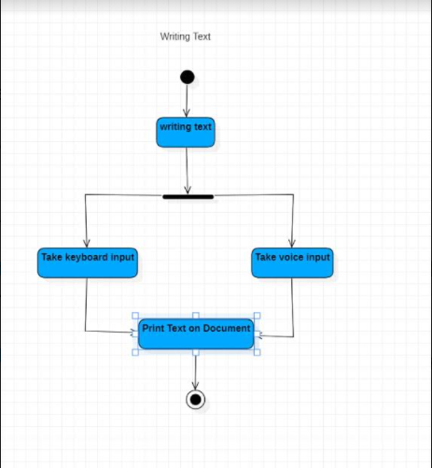
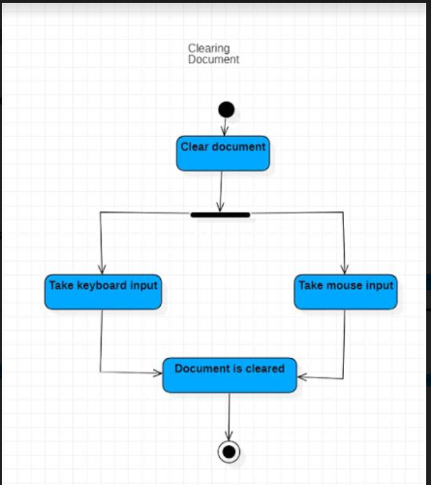
PROJECT DESIGN

Slide 11
IMPLEMENTATION

Slide 12
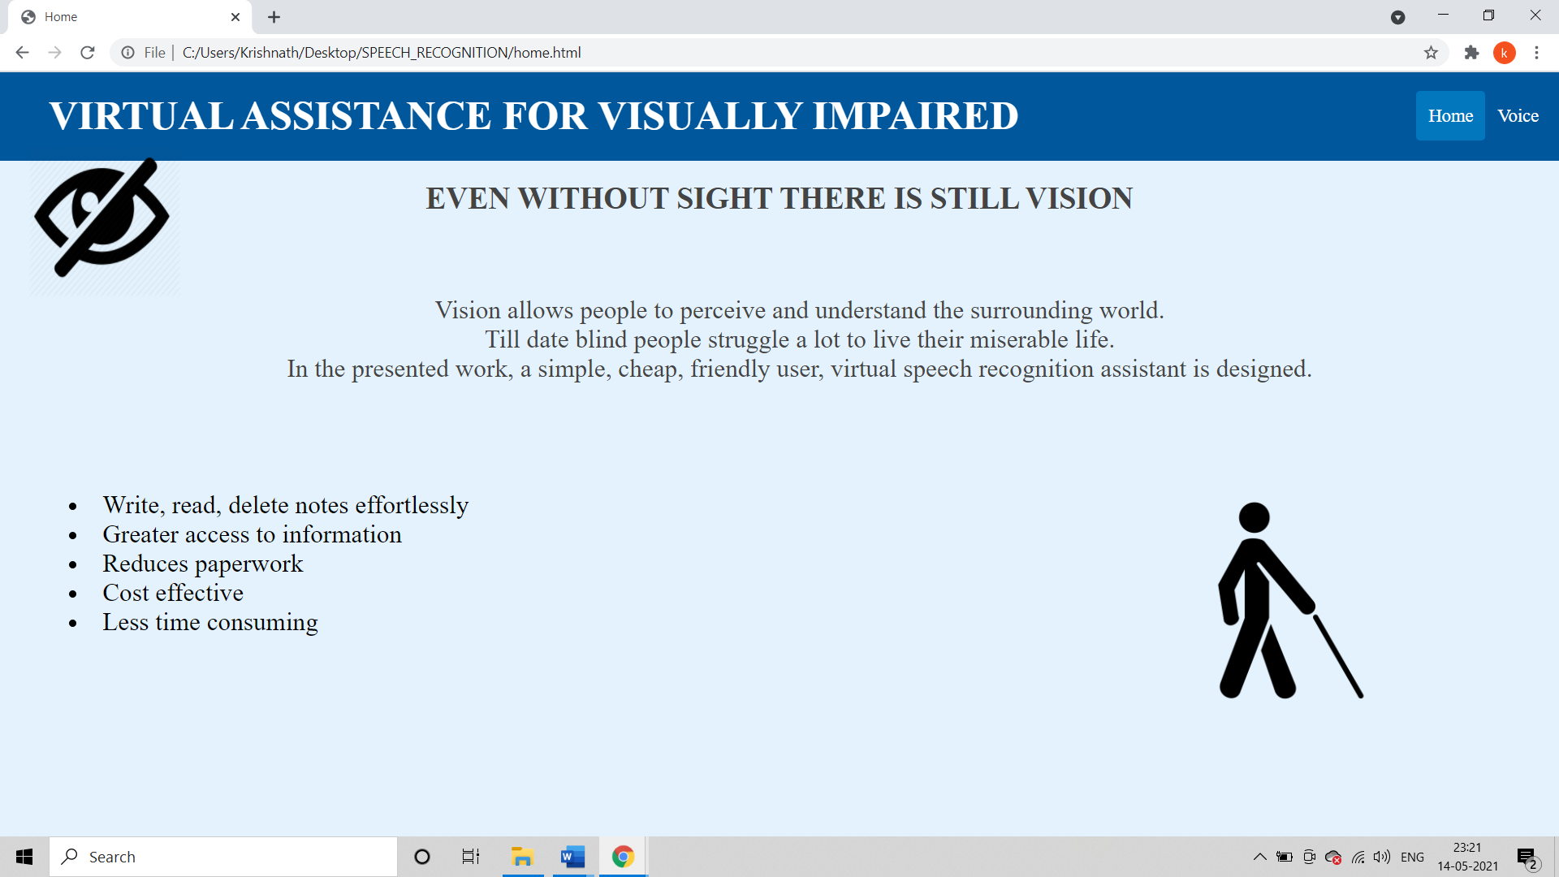

Slide 13
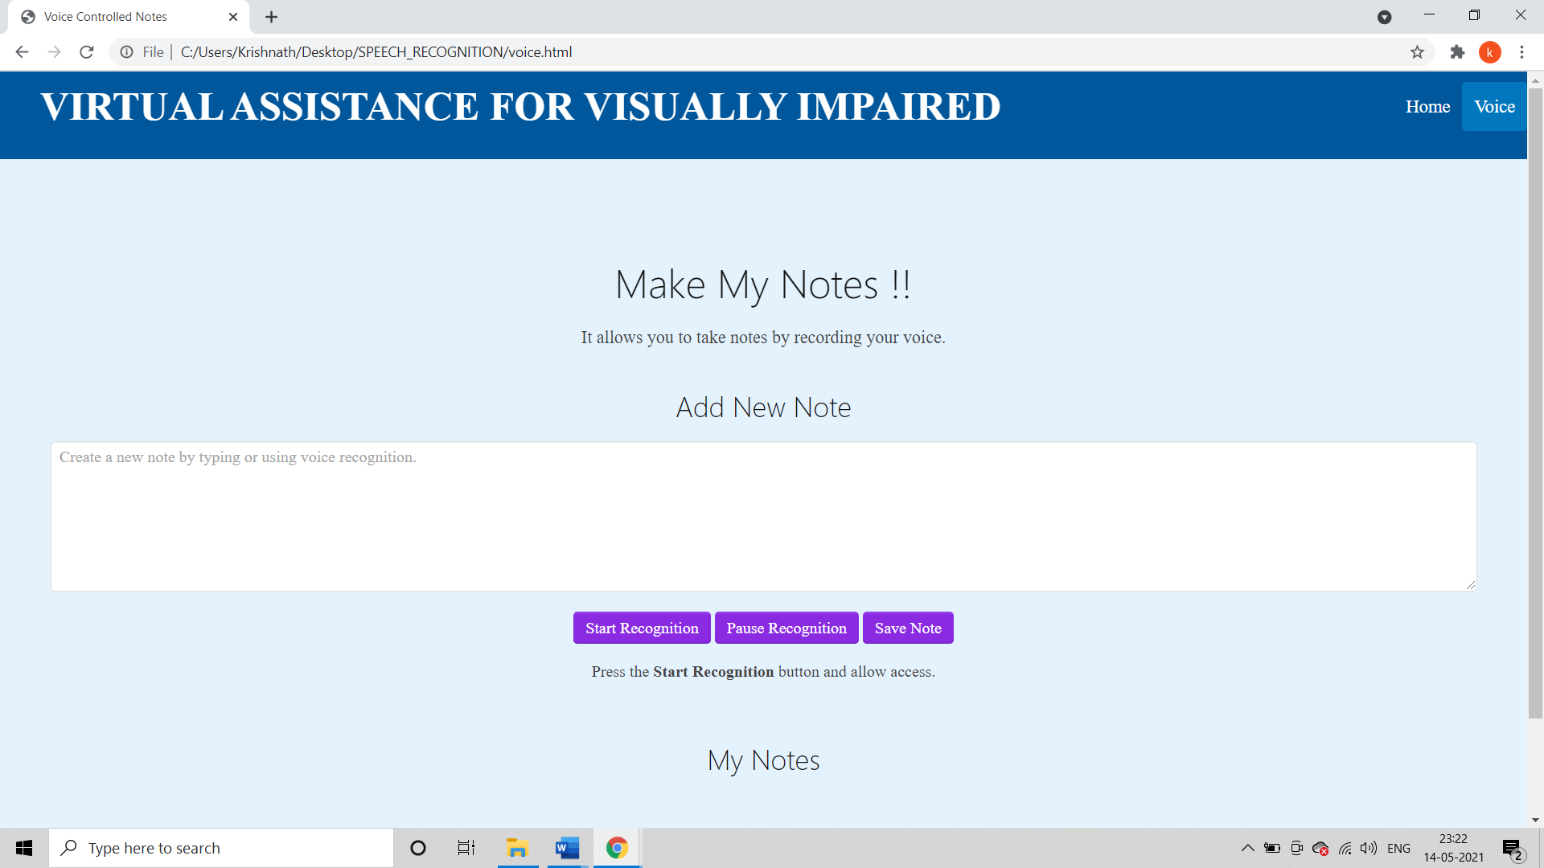

Slide 14
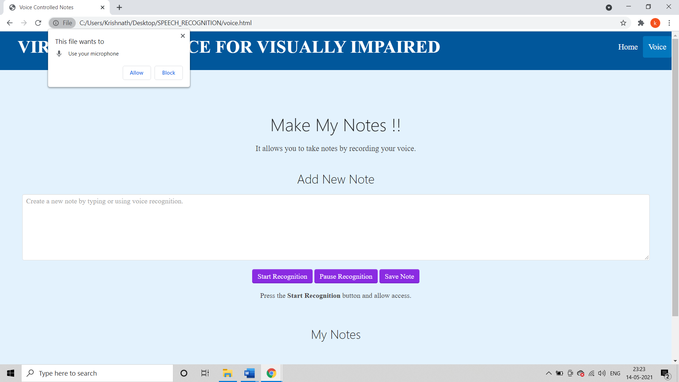

Slide 15
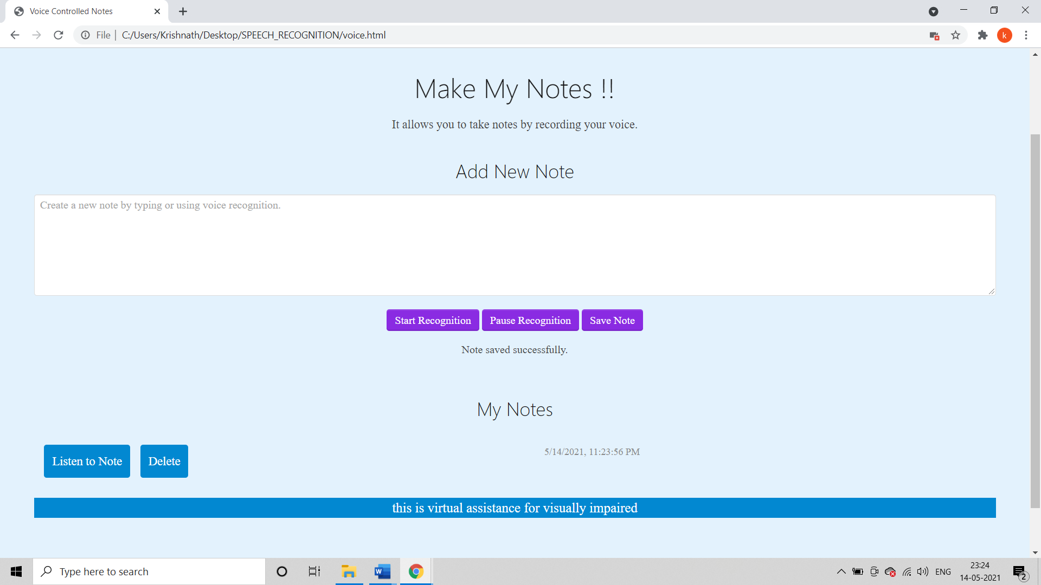

Slide 16
Time and cost efficient.
Reduce the paperwork.
User Friendly.
Low maintenance cost.
Volume of data is not an issue.
ADVANTAGES

Slide 17
Institute
Industry
Commercial
Personal
APPLICATIONS

Slide 18
A simple, cheap, configurable, easy to handle digital guidance system is proposed to provide constructive assistant and support for blind and visually impaired persons. The system is designed, implemented, tested, and verified. The real-time results of the system are encouraging. The results indicate that the system is efficient and unique in its capability in storing information as well as accessing it.
CONCLUSION

Slide 19
www.w3schools.com
www.getbootstrap.com
www.cssgradient.io
www.cdnjs.com
https://www.researchgate.net/publication/320387382_The_Needs_and_Problems_of_Students_with_Visual_Impairment
https://www.researchgate.net/publication/324437550_Research_Proposal_on_Education_for_the_Visually_Impaired_Students
REFERENCES

Slide 20
THANK YOU FOR YOUR TIME ☺

